Slide 1
PROJECT PRESENTATION
Real Time Device to Device
Wireless Communication System
Using ESP-NOW Protocol
A two node embedded system combining ultrasonic and motion sensing, communicating
directly over ESP-NOW without any Wi-Fi router, internet, or cloud service.
Abdul Rehman
Registration No: 0000674917 | Program: BSCS
Supervisor: Israr Akhter
TOTAL TIME
14 - 15 minutes

Slide 2
Introduction and Problem Statement
1 minute
Wireless sensing systems monitor spaces and detect movement automatically
Most designs still depend on a Wi-Fi router or a cloud server
That dependency means recurring cost and a single point of failure
A single sensor alone often gives false or unreliable detections
This project fixes both problems in one design
Why ESP-NOW?
W
Direct board to board link using only MAC addresses, no router needed
S
Built into ESP8266 and ESP32 by Espressif Systems
F
Low latency, low power, works with no internet at all
Problem: one sensor working alone cannot be trusted for a real alert.
2

Slide 3
Objectives
45 seconds
Combine ultrasonic and PIR sensors for reliable detection
1
Build a direct ESP-NOW link between two NodeMCU boards
2
Show live status through simple LED indicators
3
Demonstrate a low cost, router free communication model
4
3

Slide 4
System Overview and Architecture
1 minute
Sensors
Sender Node
(ESP8266)
ESP-NOW
Protocol
Receiver Node
(ESP8266)
HC-SR04 Ultrasonic
+
SR505 PIR Motion
Reads sensors, confirms
for 1 second, applies
cooldown logic
Direct MAC to MAC
wireless packet
no router used
Lights LED, prints
status, logs to
LittleFS memory
Two independent nodes, connected only through a wireless ESP-NOW link. No Wi-Fi router, internet, or cloud service is involved anywhere in the pipeline.
Local status: Red = both sensors triggered | Yellow = motion only | Green = distance only
4

Slide 5
OSI Model Mapping of the System
1 minute
OSI Layer | Status | Role in This Project
Physical | Active | 2.4 GHz Wi-Fi radio inside each ESP8266 carries every ESP-NOW frame
Data Link | Active | ESP-NOW itself: MAC based addressing, no Wi-Fi association needed
Network | Skipped | No IP address is ever assigned, no routing decision takes place
Transport | Skipped | No TCP or UDP; the send callback is a data link level acknowledgment
Session | Skipped | Connectionless design, no session state kept between transmissions
Presentation | Active | Shared struct_message format, identical on both boards
Application | Active | Sensor fusion, confirmation timer, cooldown, LED logic, LittleFS log
5

Slide 6
Why ESP-NOW? Alternatives Considered
1 minute
Skips Network, Transport and Session layers, so no router or internet path is ever needed
Built natively into the ESP8266 chip, no extra radio hardware or cost
Designed for small, infrequent packets, exactly what this project sends
Literature review: longer range than BLE at similar power, lower latency than full Wi-Fi association
Alternative Protocol | Reason Not Selected
Bluetooth Low Energy | Needs pairing and bonding, shorter range than ESP-NOW
Standard Wi-Fi + TCP/IP | Brings back the router and internet dependency this project avoids
Zigbee | No native radio on ESP8266, needs an extra costly module
LoRa | Too complex and low bandwidth for a short range, indoor, two node link
ESP-MESH | Built for many nodes; unnecessary for a fixed two node system, noted as future work
6

Slide 7
Hardware Components
1 minute
Component | Qty | Purpose
NodeMCU ESP8266 | 2 | Main controller board with built in Wi-Fi radio
HC-SR04 Ultrasonic Sensor | 1 | Measures distance using sound wave reflection
SR505 PIR Motion Sensor | 1 | Detects movement of a nearby warm body
LEDs (Red, Yellow, Green) | 5 | Show sensor and detection status visually
Resistors (220Ω) | 5 | Protect each LED from overcurrent
Breadboard, Jumper Wires, USB Cable | - | Wiring, mounting and power for both boards
7

Slide 8
Software and Technologies Used
45 seconds
1
1
2
2
3
3
4
4
Arduino IDE
C / C++
ESP-NOW Library
LittleFS File System
Writing and uploading code to both NodeMCU boards
Programming language used for sender and receiver logic
Handles direct peer to peer wireless communication
Stores a permanent detection log on flash memory
8

Slide 9
Working Methodology
1.5 minutes
Sender Node
Receiver Node
1
Read ultrasonic distance and PIR motion state
1
Stay silent, default green LED shown
2
If both sensors agree, start a 1 second check
2
Wait for an ESP-NOW packet to arrive
3
Distance stays stable -> detection confirmed
3
On arrival: turn red LED on, print status
4
Send packet to Receiver over ESP-NOW
4
Append the same line to LittleFS log file
5
Start a 3 second cooldown before next check
5
No packet for 4 seconds -> fall back to green
9

Slide 10
Implementation: Circuit & Code
1.5 minutes
Circuit Connections
Code Structure
D5 / D6 -> HC-SR04 trigger and echo pins
D7 -> SR505 PIR sensor output
D1 / D2 / D3 -> Green, Red, Yellow LEDs
Common ground shared across all components
esp_now_init() sets up wireless communication
Sender: esp_now_send() transmits confirmed data
Receiver: esp_now_register_recv_cb() listens for packets
LittleFS.open() writes each detection to the log file
Both boards were assembled on a breadboard and tested using the Arduino Serial Monitor before final verification.
10

Slide 11
Results and Live Demonstration
2 minutes
Test Condition | Observed Outcome
Only one sensor active | No packet sent, Receiver stays green
Both sensors, object pulled away early | Confirmation cancelled, nothing sent
Both sensors held steady for 1 second | Packet sent, red LED on, one log line saved
Detection held for 10+ seconds | Cooldown keeps message rate low, red LED steady
Sender powered off or out of range | Receiver falls back to green after 4 seconds
Live demo: place an object within 20 cm while moving your hand to trigger both sensors together.
11

Slide 12
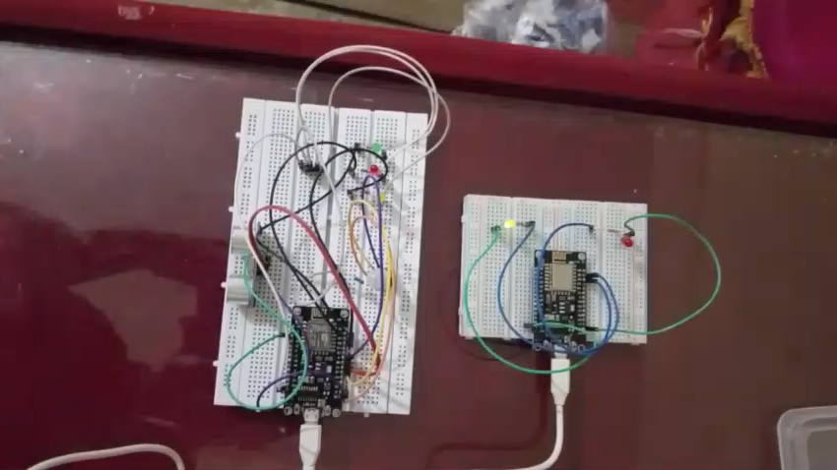
Live Demo
19 seconds

Slide 13
Challenges and Future Improvements
1 minute
Current Challenges
Future Improvements
Limited wireless range compared to open Wi-Fi
Only one Sender can talk to one Receiver
Threshold and timing values are fixed in code
Log time stamps reset after every reboot
Add buzzer or mobile notification alerts
Show live distance on a small OLED display
Support multiple Sender boards at once
Add real time clock for accurate log stamps
13

Slide 14
45 seconds
Conclusion
Built a working, low cost, internet free detection system
Combining two sensors made detection far more reliable
ESP-NOW gave a fast, direct, router free wireless link
The system logs every confirmed detection automatically
A solid foundation for future security and IoT projects
14

Slide 15
30 seconds
Thank You
Questions?
Real Time Device to Device Wireless Communication System Using ESP-NOW Protocol
Abdul Rehman | BSCS | Allama Iqbal Open University
15

